Slide 1


Git, GitHub, and Terminal
An Introduction
Imam Abdulrahman Bin Faisal University
College of Computer Science and Information Technology
Teaching Assistant in Computer Engineering Department
Ms. Rema Alnssiry
Ms. Somiah Aljaafary
Ms. Hind Alzahrani
V1 - 2026

Slide 2
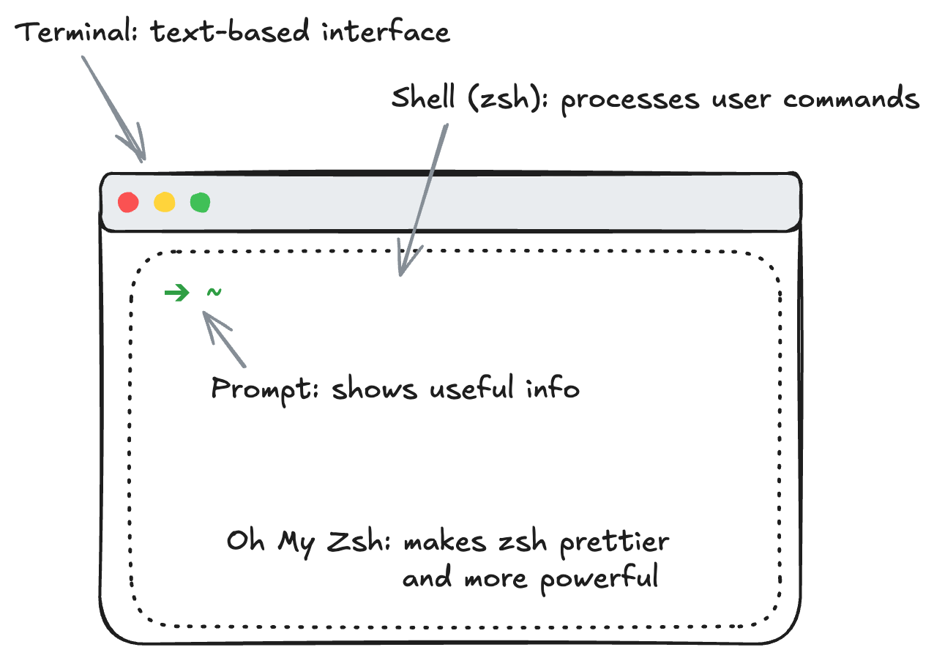
Terminal
Surviving in the terminal:
pwd
ls -l
mkdir <directory>
cd <path>
touch <file>
rm <file> # rm -r <directory>
mv <from> <to>

Slide 3
Python
pyenv
We used pyenv to install and manage multiple Python versions.
pyenv versions
pyenv install <version>
pyenv global <version>
virtualenv
pyenv virtualenvs
A safe place to pip install <package> without interfering with other tools.
Real situation:
Suppose you have Project A depending on pandas==1.4.4 and Project B on pandas==2.2.3, what can we do?
You can isolate those dependencies in two different virtualenvs.

Slide 4
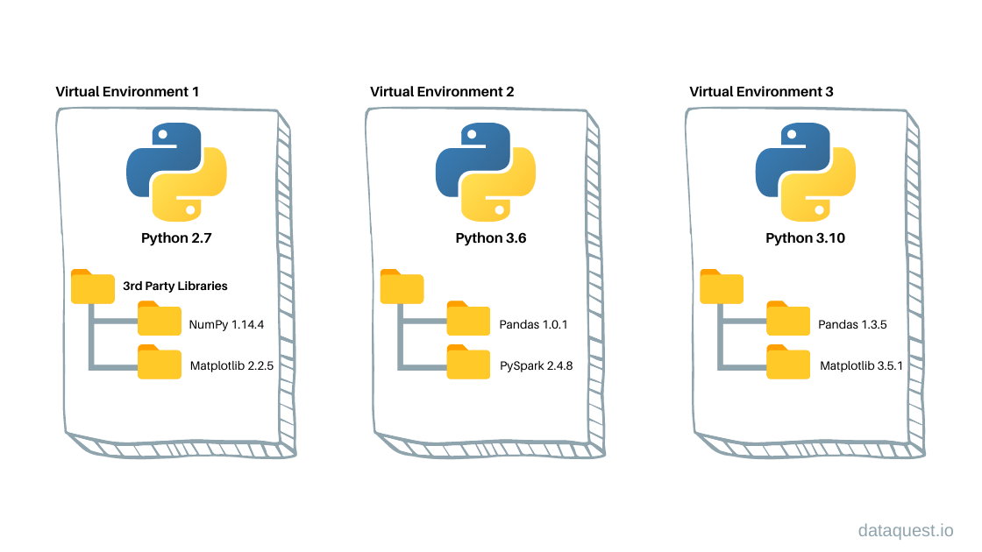
Python
In the first weeks we'll use only one virtual environment called ai.
It will be set by default when starting a new shell.

Slide 5
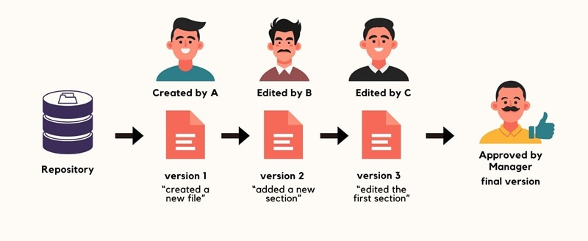
What Is Version Control?
Version Control is a system that tracks changes to files over time.
It’s like a smart tool that helps people work together on projects, especially on computer programs.
Why it is important:
Keeps history of changes
Allows reverting to previous versions
Supports collaboration
Prevents accidental data loss

Slide 6


!=

Slide 7
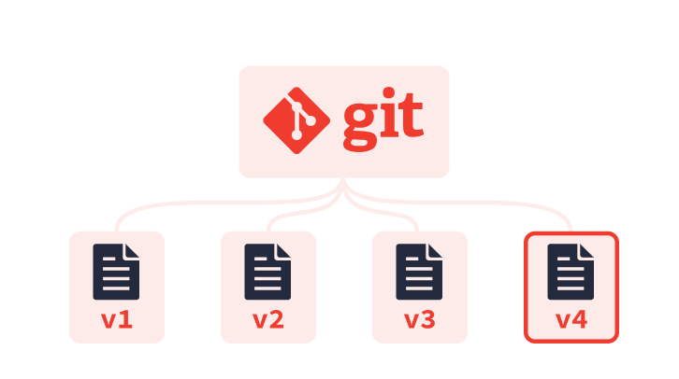
What Is Git?
Git is a distributed version control system.
Tracks changes in files
Fast and Reliable
Works Offline
Used Via Command Line or tools like GitHub Desktop

Slide 8
Key Git Concepts
Repository (Repo): Project folder
Commit: Saved snapshot of changes
Branch: Separate line of development
Merge: Combine branches
Clone: Copy a repository
Push: Upload changes
Pull: Download changes

Slide 9
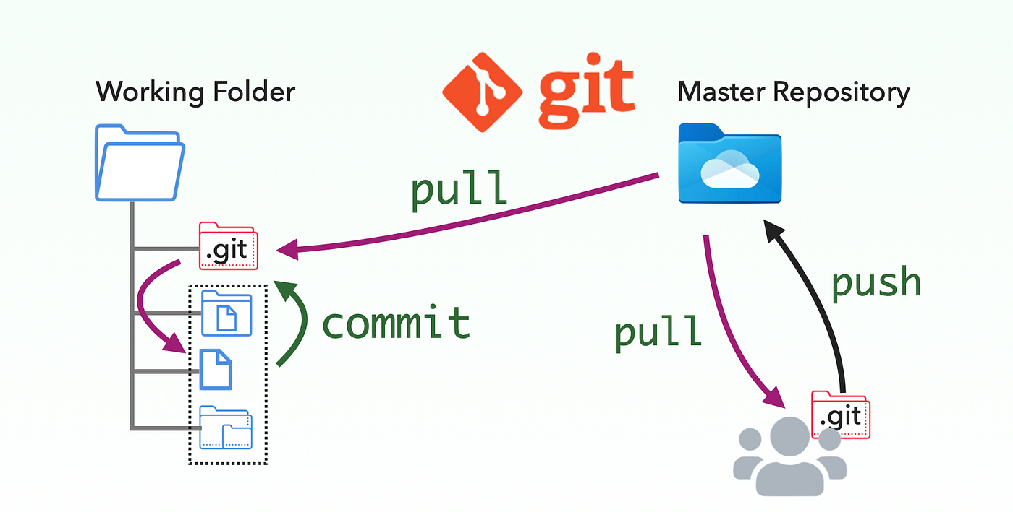

Slide 10
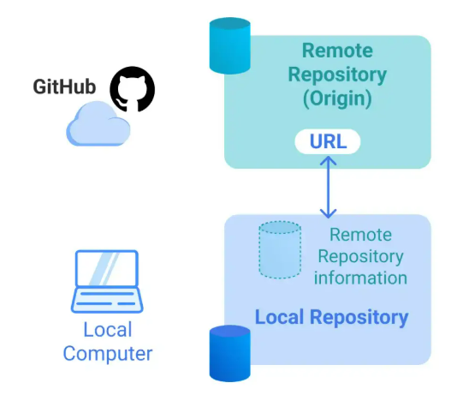
Repository (Repo)
A repository is a central project folder where all files, folders, and their complete change history are stored.
Contains source code, documents, and configuration files
Local Repository: on your computer
Remote Repository: on GitHub

Slide 11
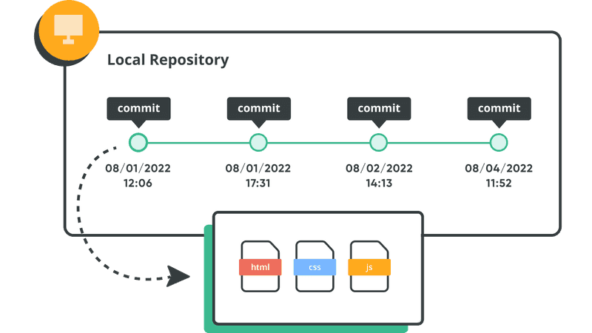
Commit
A commit is a saved snapshot of changes made to files in the repository at a specific point in time.
Records what was changed, when, and by whom
Includes a commit message describing the changes
Helps restore previous versions if needed

Slide 12
Clone
A clone creates a local copy of a remote repository on your computer.
Downloads all files and version history
Allows offline work
Keeps connection to the remote repository for updates

Slide 13
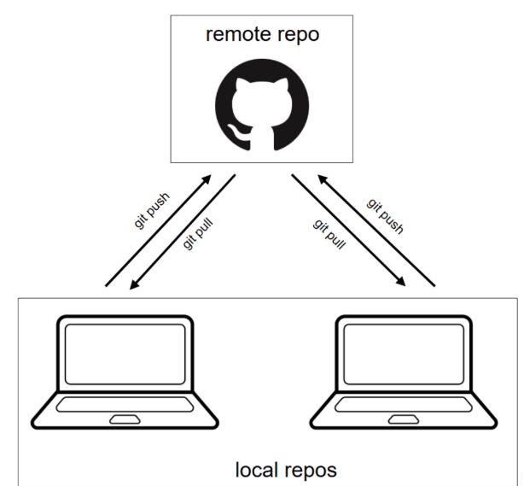
Push
A push uploads committed changes from a local repository to a remote repository.
A pull downloads and integrates changes from a remote repository into your local repository.

Slide 14
What Is GitHub?
GitHub is a cloud-based platform for hosting Git repositories.
Stores code online
Enables collaboration
Provides issue tracking
Supports project management
Widely used in open-source projects

Slide 15
Git vs GitHub
Git | GitHub
Version control tool | Hosting platform
Runs locally | Runs online
Tracks file changes | Shares and manages repos
Command-line based | Web interface

Slide 16
GitHub Features
Repositories
Pull Requests
Issues
Actions (CI/CD)
Forking
Collaboration tools

Slide 17

Forking
Forking is the process of creating a personal copy of someone else’s repository under your own GitHub account.
It allows you to freely experiment with changes without affecting the original project.
Forking | Cloning
Creates a copy on GitHub | Creates a copy on your computer
Used for contributing to others’ projects | Used for local development
Independent repository | Linked to a remote repository

Slide 18
Basic Git Workflow
Make Changes to Files
Push to GitHub
1
2
3
4
5
Create a Repository
Commit Changes
Pull Updates from other Developers

Slide 19
Git
Surviving with git:
cd ~/code/<YOUR_GITHUB_NICKNAME>
git clone <ssh_url> # From GitHub, e.g. github.com/rfalnsari/git
cd <repo>
Working on master:
git status # Should be clean before you start working
code . # Working in VS Code on those files
git status # What files were added/removed/changed since last commit?
git diff # What lines were added/removed since last commit?
# Creating a new commit (2-step process)
git add <file1> <file2>
git commit -m "A MEANINGFUL MESSAGE"
# Pushing commit to GitHub
git push origin master

Slide 20
Advanced Git Topics
The following Git concepts will be introduced later in the course, during the project weeks, when you will be working in teams:
Pull
Merge
Branches & GitHub Flow
Resolving merge conflicts
Set Up Your Device:
macOS: https://www.notion.so/Setup-instructions-for-mac-2e75ea763bc88012a4c9f59b5bd92739?source=copy_link
Windows: https://www.notion.so/Setup-instructions-for-Windows-2f15ea763bc880228a34c81ea20380bc?source=copy_link

Slide 21
Resources
GitHub Docs
GitHub Skills
GitHub Deskstop
Markdown Language

